Slide 1

Lab 1: Data Analysis with Python

Slide 2
Objectives
Create a Jupyter notebook
Apply data analysis and modeling techniques to housing price data
Answer 11 questions: implement using Python code
Lab 1: Data Analysis with Python

Slide 3
Project Scenario
In this assignment, you are a Data Analyst working at a Real Estate Investment Trust. The Trust would like to start investing in Residential real estate. You are tasked with determining the market price of a house given a set of features. You will analyze and predict housing prices using attributes or features such as square footage, number of bedrooms, number of floors, and so on. A template notebook is provided in the lab; your job is to complete the ten questions. Some hints to the questions are given in the template notebook.
Lab 1: Data Analysis with Python
Notes:
https://www.kaggle.com/datasets/harlfoxem/housesalesprediction?utm_medium=Exinfluencer&utm_source=Exinfluencer&utm_content=000026UJ&utm_term=10006555&utm_id=NA-SkillsNetwork-wwwcourseraorg-SkillsNetworkCoursesIBMDeveloperSkillsNetworkDA0101ENSkillsNetwork20235326-2022-01-01

Slide 4
Data sets
The dataset contains house sale prices for King County, which includes Seattle.
It includes homes sold between May 2014 and May 2015
Lab 1: Data Analysis with Python

Slide 5
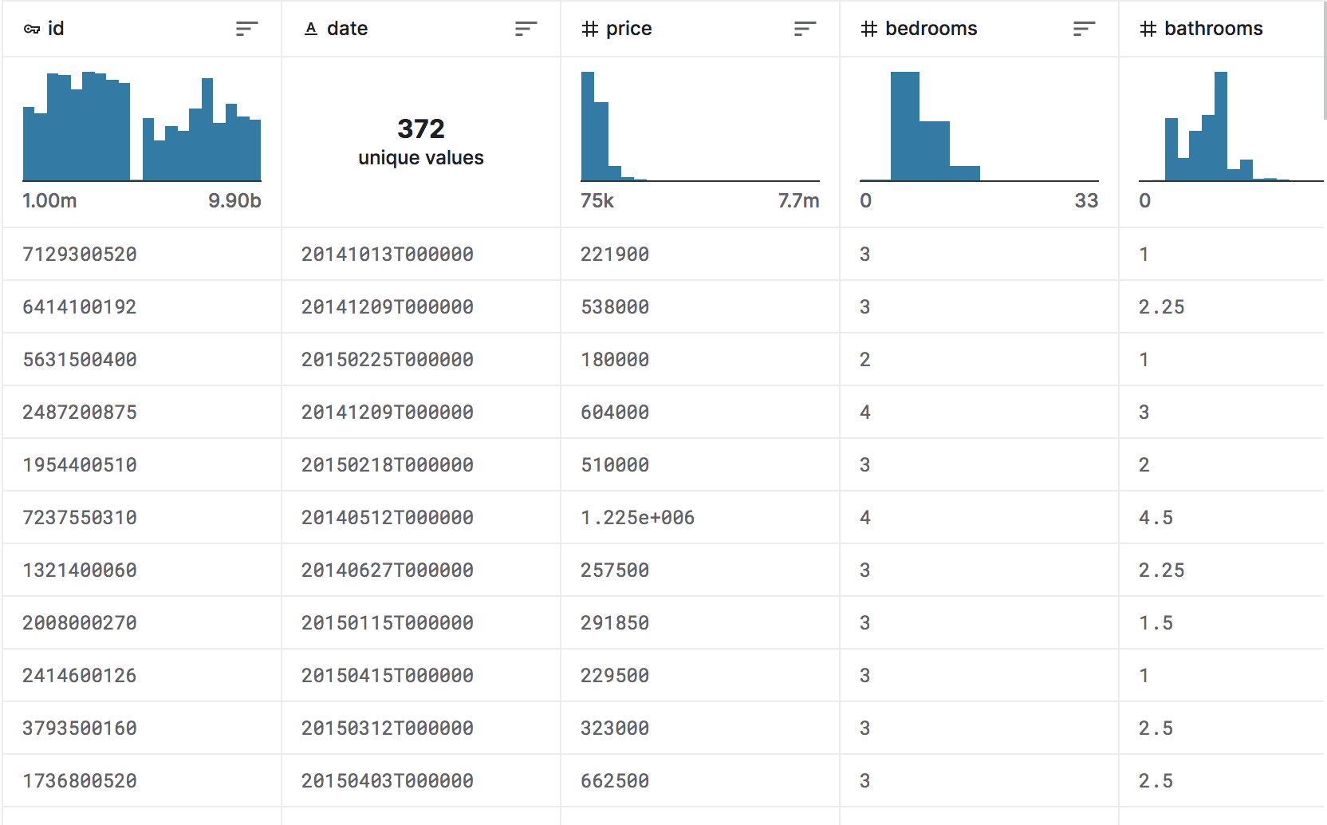
Data sets
Lab 1: Data Analysis with Python

Slide 6
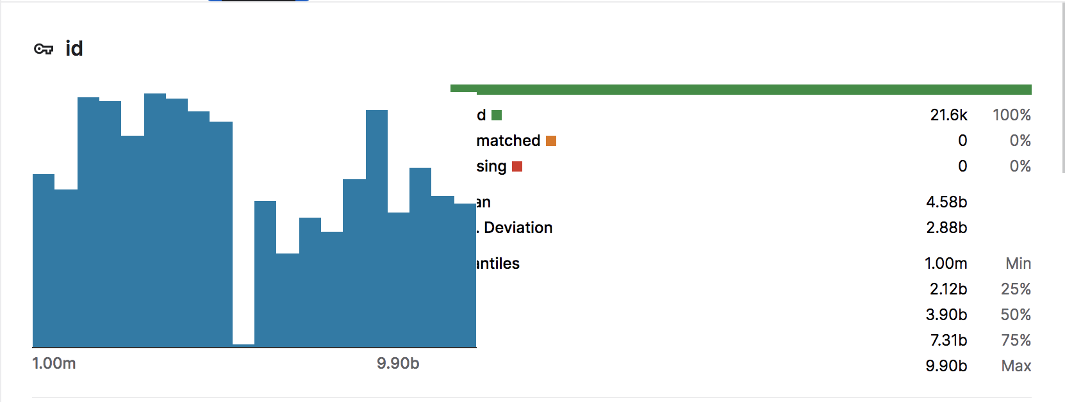
Data sets
Lab 1: Data Analysis with Python

Slide 7
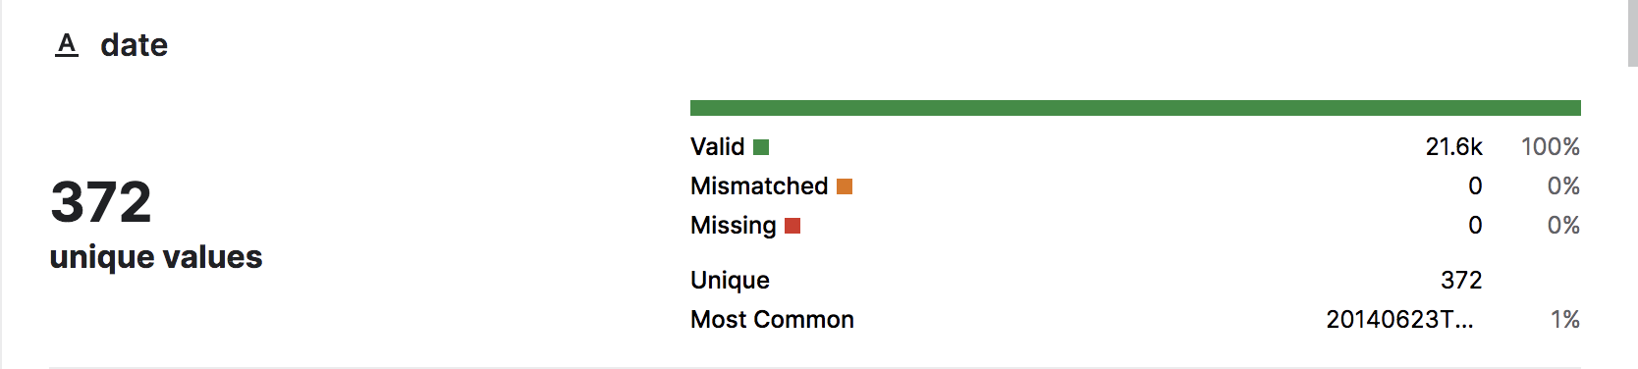
Data sets
Lab 1: Data Analysis with Python

Slide 8
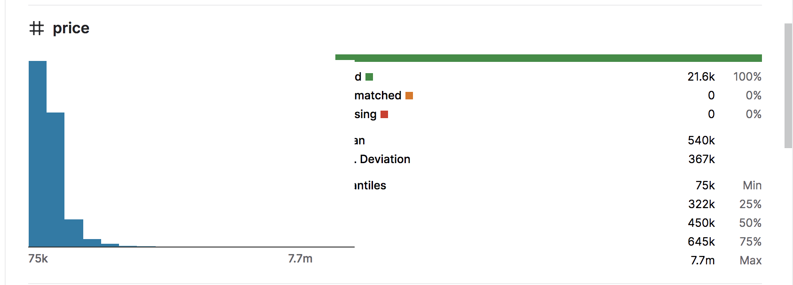
Data sets
Lab 1: Data Analysis with Python

Slide 9
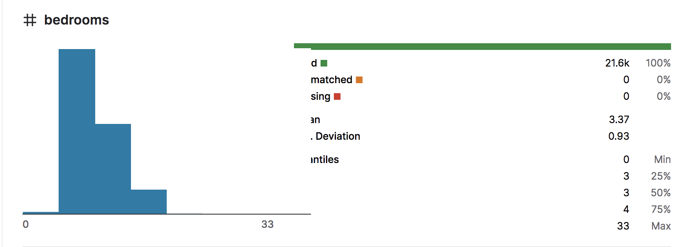
Data sets
Lab 1: Data Analysis with Python

Slide 10
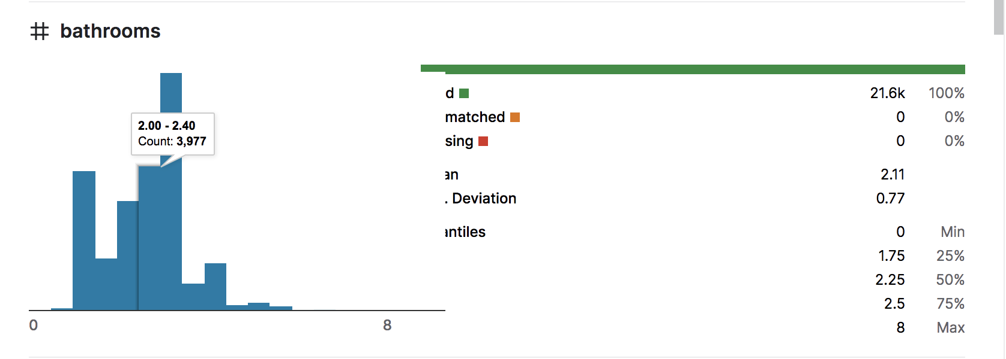
Data sets
Lab 1: Data Analysis with Python

Slide 11
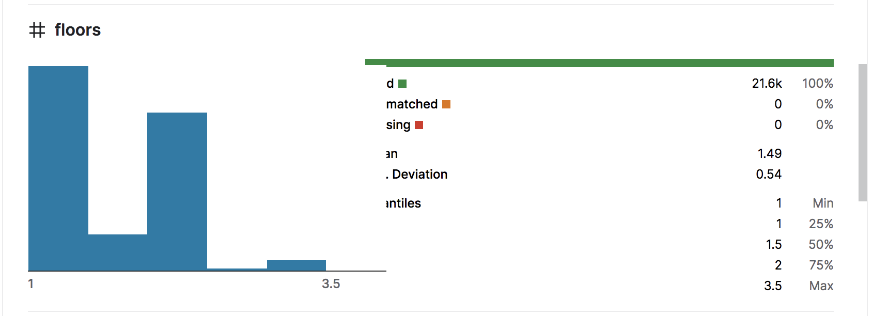
Data sets
Lab 1: Data Analysis with Python

Slide 12
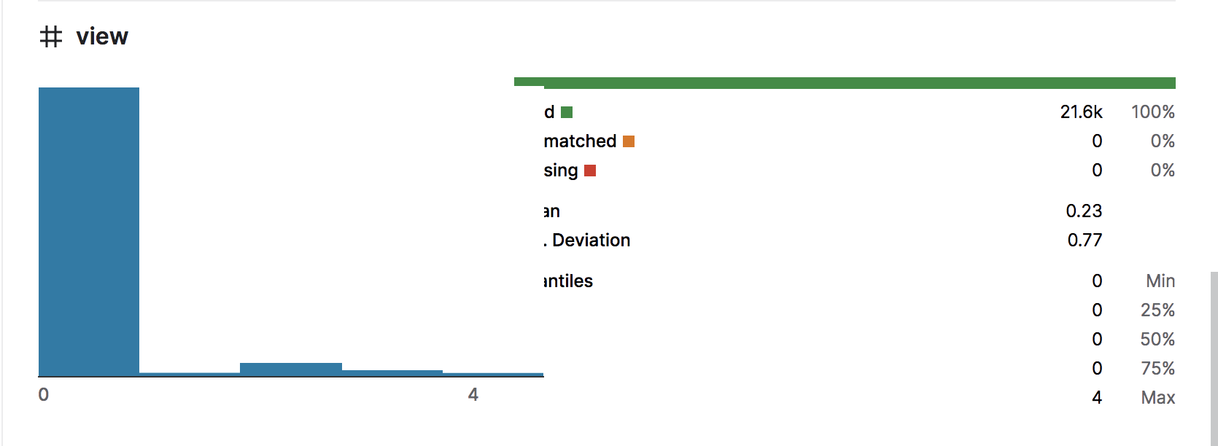
Data sets
Lab 1: Data Analysis with Python

Slide 13
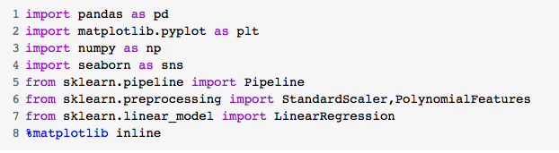
Question and Solution
Question 1
  Display the data types of each column using the function dtypes
Lab 1: Data Analysis with Python

Slide 14

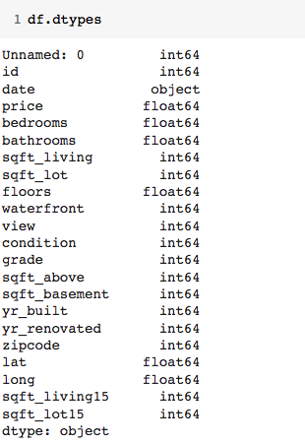

Question and Solution
Question 1: results
Lab 1: Data Analysis with Python

Slide 15
Question and Solution
Question 2
  Drop the columns "id" and "Unnamed: 0" from axis 1 using the method drop(), then use the method describe() to obtain a statistical summary of the data
Lab 1: Data Analysis with Python

Slide 16
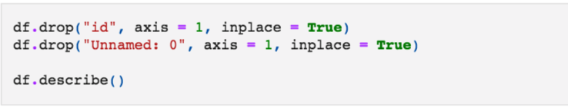
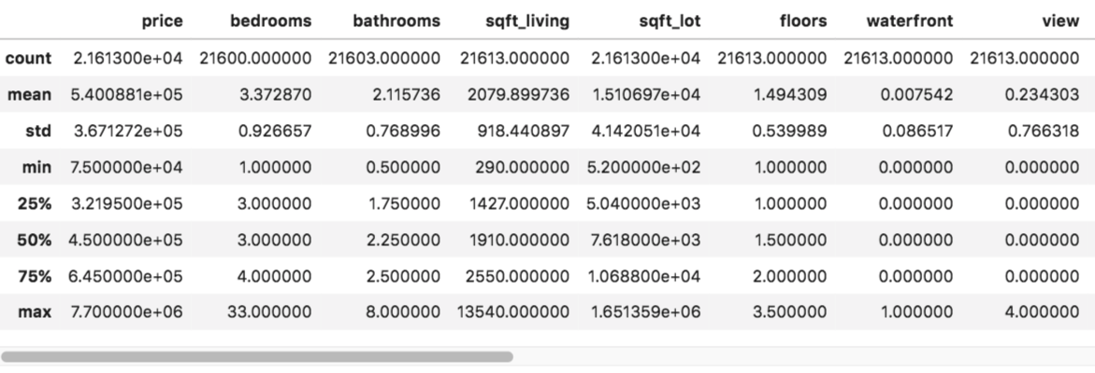
Question and Solution
Question 2
Lab 1: Data Analysis with Python

Slide 17

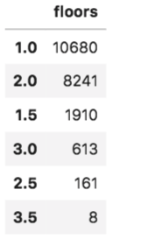
Question and Solution
Question 3
  Use the method value_counts to count the number of houses with unique floor values, use the method .to_frame() to convert it to a dataframe.
Lab 1: Data Analysis with Python

Slide 18

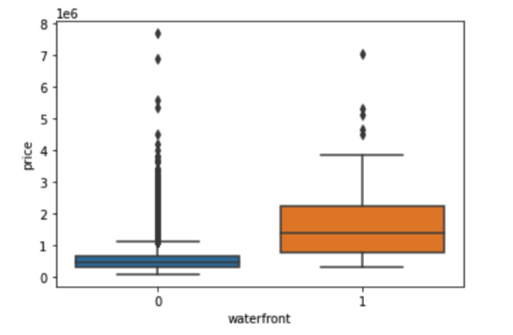
Question and Solution
Question 4
  Use the function boxplot in the seaborn library to determine whether houses with a waterfront view or without a waterfront view have more price outliers.
Lab 1: Data Analysis with Python

Slide 19
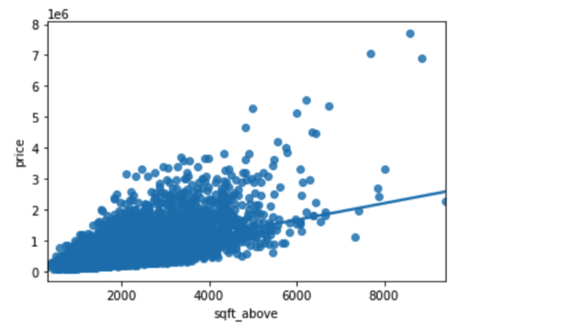
Question and Solution
Question 5
  Use the function regplot in the seaborn library to determine if the feature sqft_above is negatively or positively correlated with price.
Lab 1: Data Analysis with Python

Slide 20
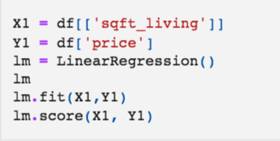

Question and Solution
Question 6
  Fit a linear regression model to predict the 'price' using the feature 'sqft_living' then calculate the R^2.
Lab 1: Data Analysis with Python

Slide 21
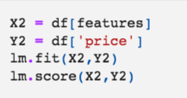

Question and Solution
Question 7
  Fit a linear regression model to predict the 'price' using the list of features: features =["floors", "waterfront","lat" ,"bedrooms" ,"sqft_basement" ,"view" ,"bathrooms","sqft_living15","sqft_above","grade","sqft_living"]
  Then calculate the R^2.
Lab 1: Data Analysis with Python

Slide 22
Question and Solution
Question 8
  Create a list of tuples, the first element in the tuple contains the name of the estimator:
  'scale'
  'polynomial'
  'model'
  The second element in the tuple contains the model constructor
  StandardScaler()
  PolynomialFeatures(include_bias=False)
  LinearRegression()
  Input=[('scale',StandardScaler()),('polynomial', PolynomialFeatures(include_bias=False)),('model',LinearRegression())]
Lab 1: Data Analysis with Python

Slide 23
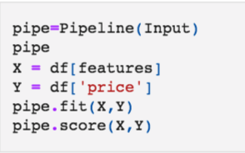

Question and Solution
Question 9
  Use the list to create a pipeline object to predict the 'price', fit the object using the features in the list features, and calculate the R^2.
Lab 1: Data Analysis with Python

Slide 24

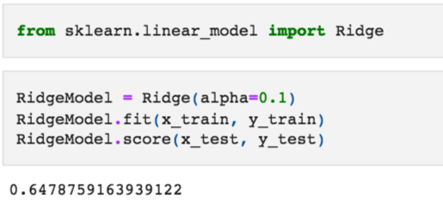
Question and Solution
Question 10
  Create and fit a Ridge regression object using the training data, set the regularization parameter to 0.1, and calculate the R^2 using the test data.
Lab 1: Data Analysis with Python

Slide 25
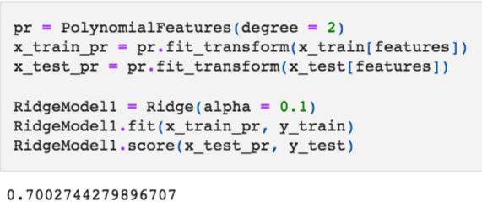
Question and Solution
Question 11
  Perform a second order polynomial transform on both the training data and testing data. Create and fit a Ridge regression object using the training data, set the regularisation parameter to 0.1, and calculate the R^2 utilising the test data provided.
Lab 1: Data Analysis with Python

Slide 26
Summary
Create a Jupyter notebook
Apply data analysis and modeling techniques to housing price data
Lab 1: Data Analysis with Python

Slide 27
Q & A
Lab 1: Data Analysis with Python

